Slide 1

EDA CASE STUDY
By- Milan Mithal & Utkarsh mehta

Slide 2
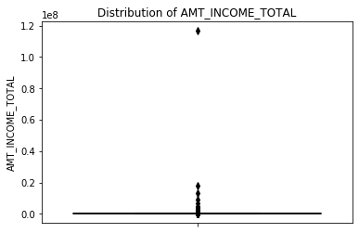
the column `AMT_INCOME_TOTAL` which tells us the income of the client. We observe a value very large which is surely an outlier.

Slide 3
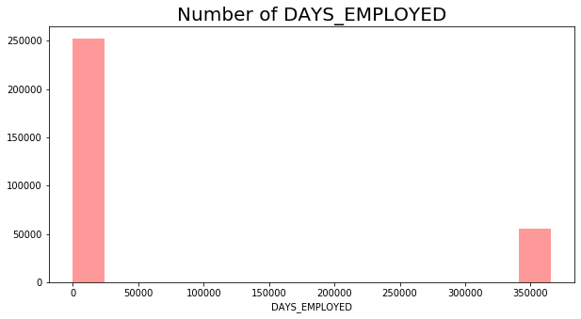
In `DAYS_EMPLOYED` which tells how many days before the application the person started his job. We observe a value which is greater that 20,000 which is surely an outlier because 25000/365 will be around `54 years`. Considering that a person started working at age of 21, the person will be 21+54 will turn out to be 75 years old.

Slide 4
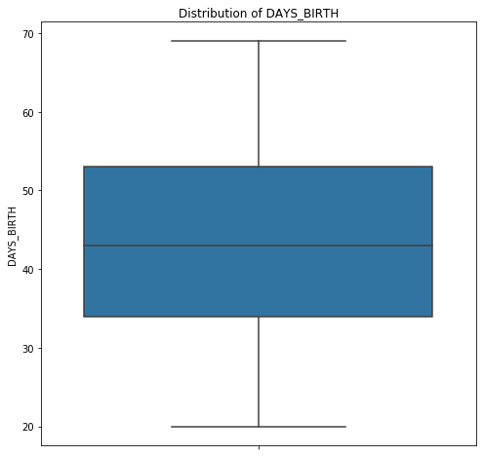
We find no outliers for DAYS_BIRTH column. We can observe that most of our customers range between `35-54 age group` which is of course a possibility because this data is for working professionals. Also , our total data lies between `20-70 years` , so nothing is wrong with this column.

Slide 5
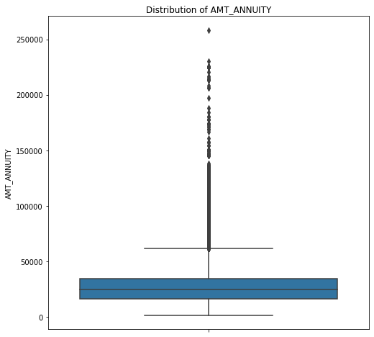
AMT_ANNUITY which tells the loan annuity. We observe a value which is greater than 250000 which looks like an outlier.

Slide 6
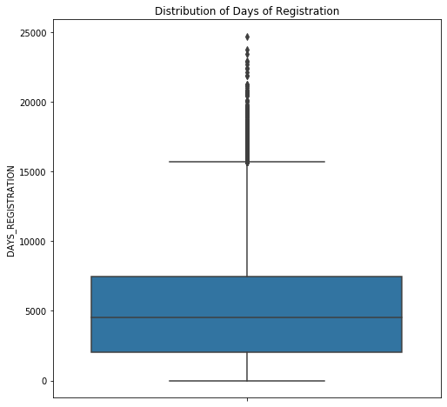
DAYS_REGISTRATION which tells how many days before the application did client change his registration. We observe values which are greater than 24000 which are outliers. Because 24000 days is almost 66 years (24000/365) and client can not have his previous registration 66 years back.

Slide 7

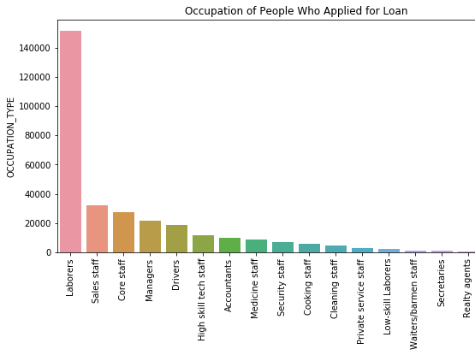
LaboUr, Sales Staff, Core Staff, Managers, Drivers occupation type have applied for loan in more number comparing to other occupation type

Slide 8
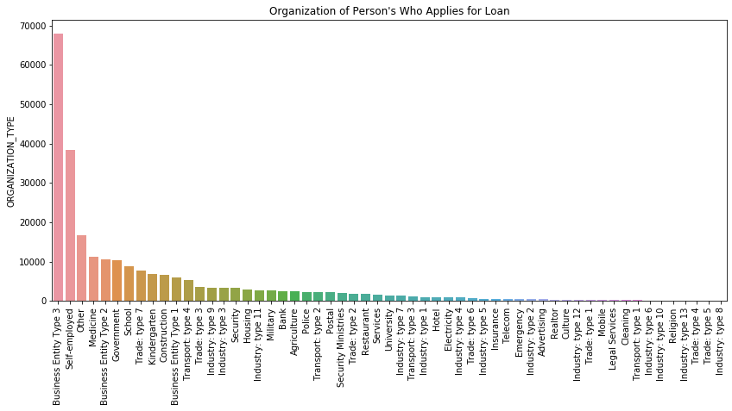
Business Type 3 Organization type have applied for loan in large number.

Slide 9
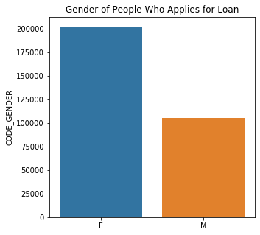
we can see that Female applicants have applied for loan more than Male applicants.

Slide 10
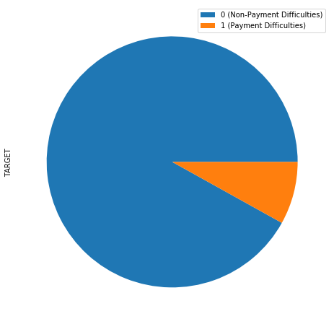
We have SEEN imbalance is higher between target variables. So We divide this dataset into two different datasets based upon 'Target' value.
0 = Loan-Non-Payment Difficulties
1 = Loan Payment Difficulties

Slide 11
Univariate Analysis of
Categorical Variables

Slide 12
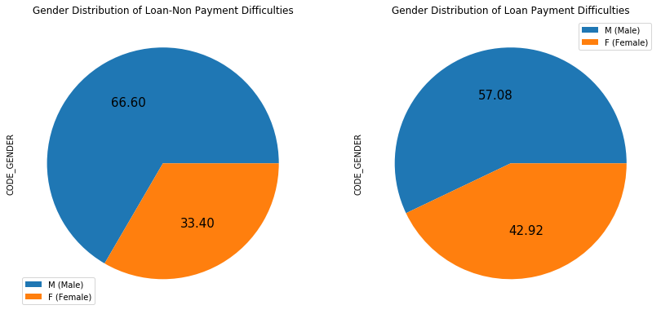
Gender Distribution
Comparing both Non-Payment difficulties & Payment difficulties based on gender, we observe that Females are at majority in both the cases. We also observe that there is an increase in the percentage in male payment difficulties from non-payment difficulties

Slide 13
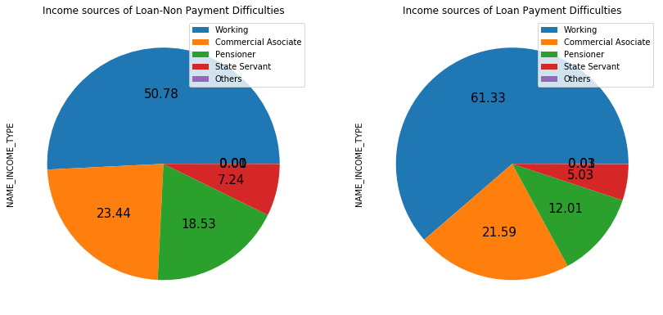
INCOME SOURCES
We observe a Decrease in the Percentage of Payment Difficulties who are Pensioners and an increase in the Percentage of Payment Difficulties who are working when compared the percentages of both payment difficulties and non-payment difficulties.

Slide 14
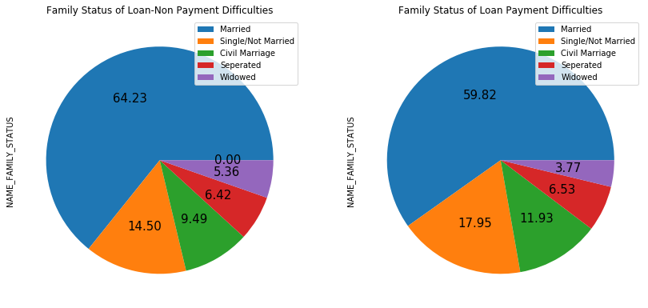
FAMILY STATUS
We observe that there is a decrease in the percentage of married and widowed with Loan Payment Difficulties and an increase in the percentage of single and civil married with Loan Payment Difficulties

Slide 15
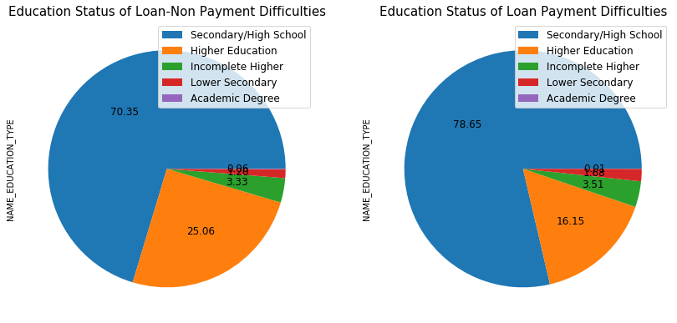
EDUCATION
We observe an increase in percentage of loan payment difficulties whose educational qualifications are secondary and a decrease in the percentage of loan payment difficulties who have completed higher education when compared the percentages of loan payment difficulties and loan non-payment difficulties

Slide 16
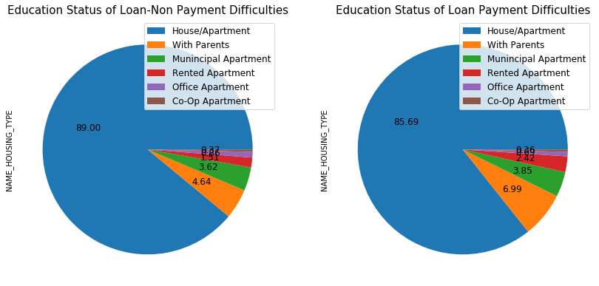
HOUSING
We observe an increase in the percentage of Payment Difficulties who live with their parents when compared to the percentages of Payment Difficulties and non-Payment Difficulties

Slide 17
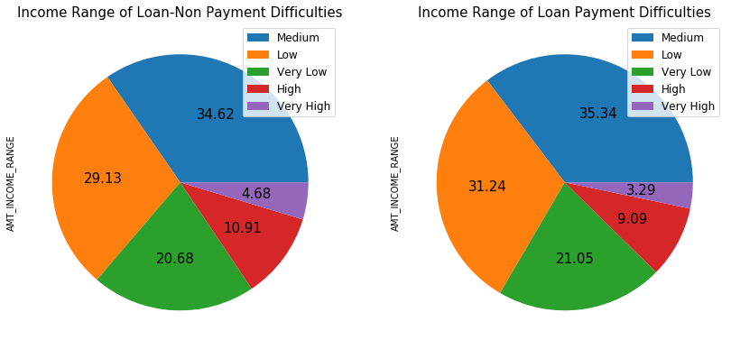
INCOME RANGE
We observe an increase in the percentage of Loan Payment Difficulties whose income is low when compared with the percentages of Payment Difficulties and Loan-Non-Payment Difficulties

Slide 18
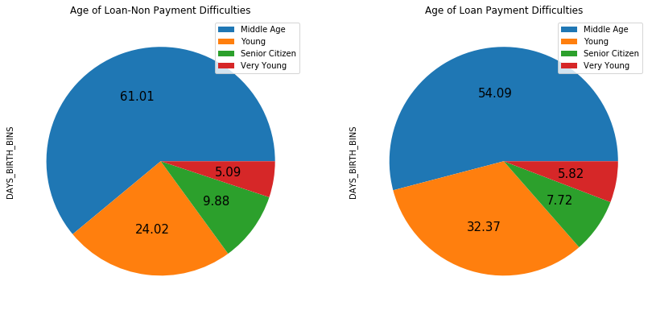
AGE
We observe that there is an increase in the percentage of Loan Payment Difficulties who are young` when compared to the percentages Loan-Non-Payment Difficulties.

Slide 19
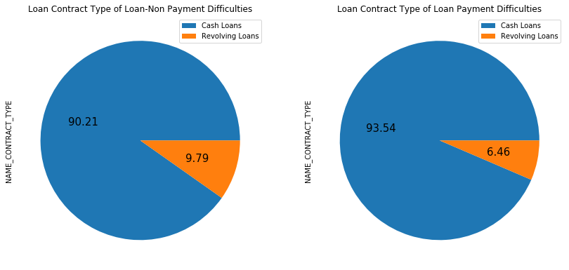
TYPE OF LOAN
We observed that cash loans are preferable than revolving loans by both Payment Difficulty & Non-Payment Difficulty applicants

Slide 20
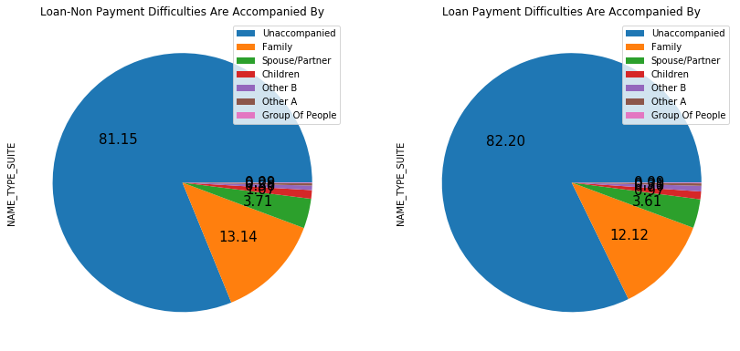
Loan Accompanied By
We do not observe any major changes here

Slide 21
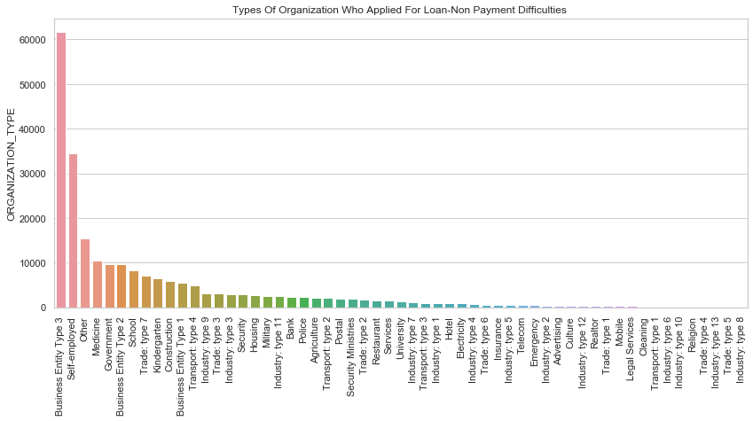
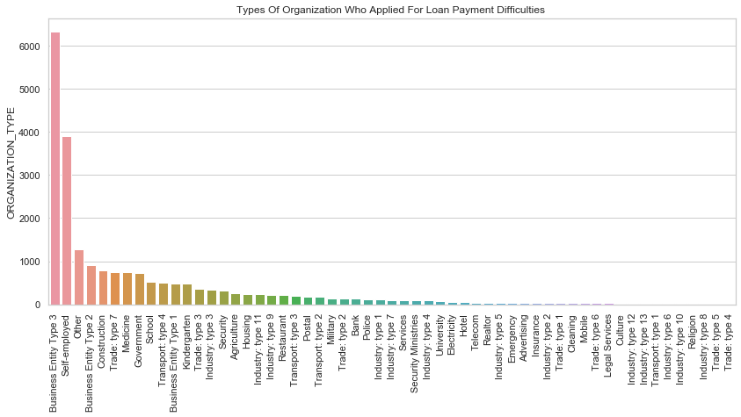
Organization Type
We do not observe any major changes here

Slide 22
Univariate Analysis of numerical Variables

Slide 23
Organization Type
We do not observe any major changes here

